Slide 1
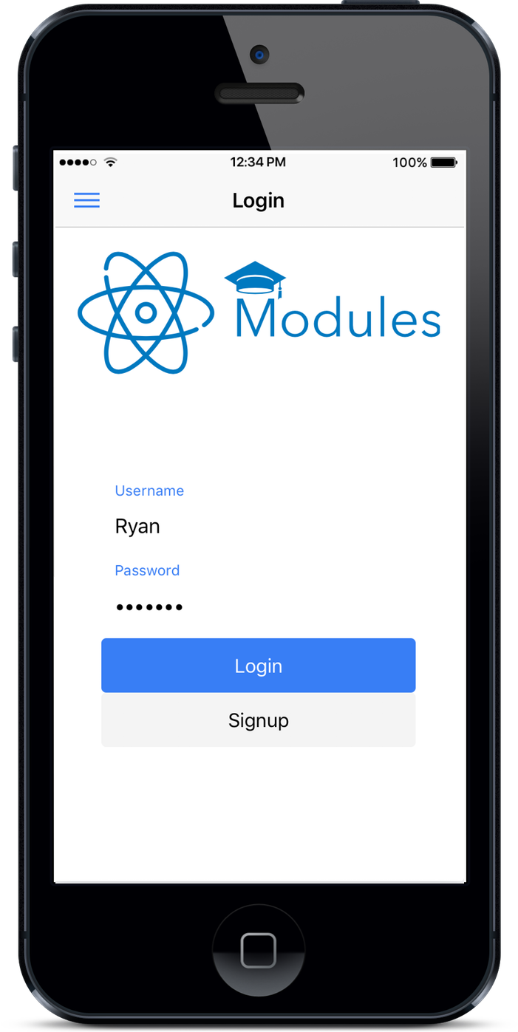
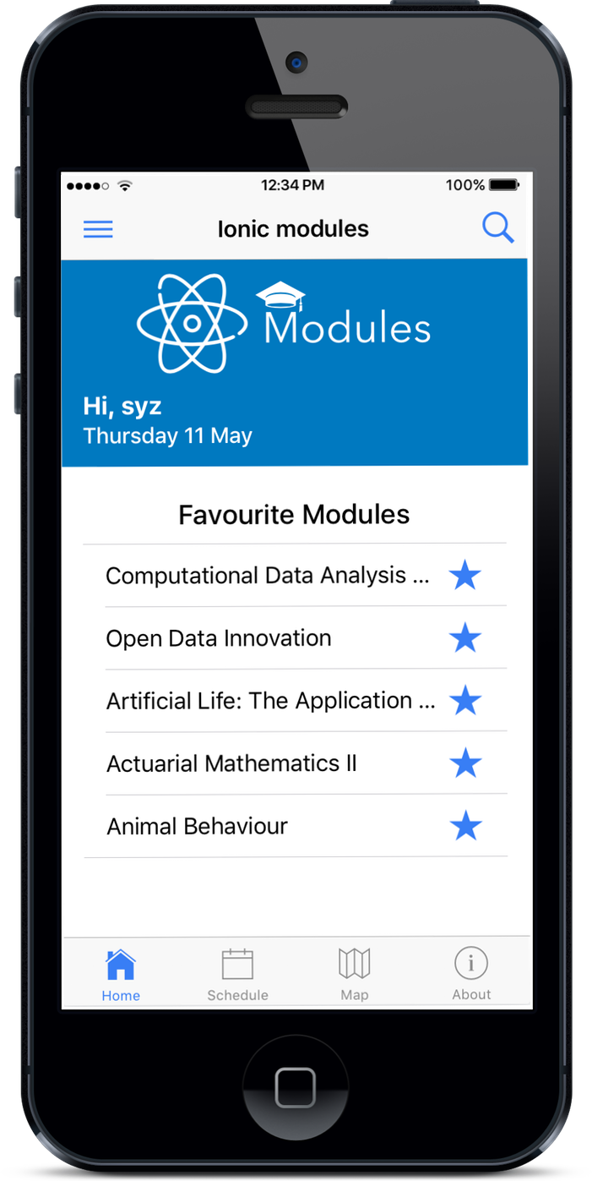
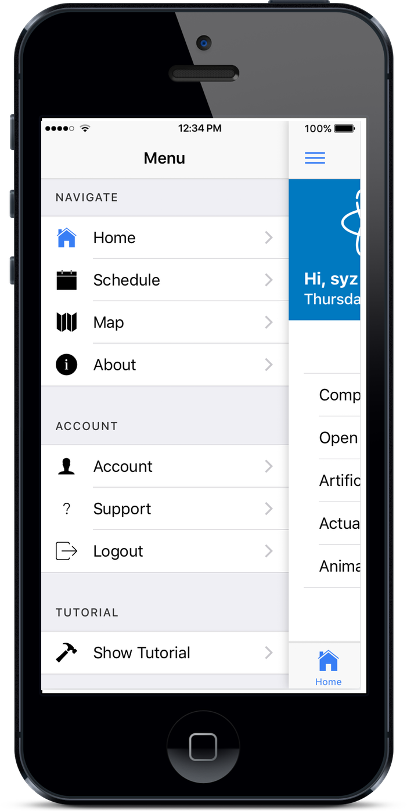
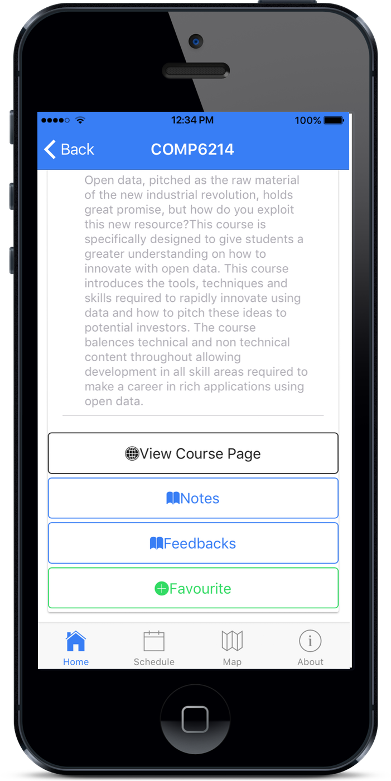
Atomic Modules – Group 8
OPEN DATA INNOVATION COMP6214
￼
Saber Hamidi | Phinephas Aasre | Yanzhong Su | Ahmet Novalić | Rihards Baranovskis
ABSTRACT
TITLE:
Atomic Modules
INTRODUCTION:
The problem, the ideas, the solution.
TECHNOLOGY:
Front-end, back-end and hosting & collaboration.
DATASETS:
University Open Data Service, Open Street Map, MOOC Open Data.
BUSINESS MODELS:
Freemium, Subscription, Advertisements. PRODUCT:
Demonstration of app functionality.
TECHNOLOGY
DATASETS
UNI OPEN DATA SERVICE
Modules data open for anyone.
Module description
PRODUCT
FRONT-END
cross-platform framework for mobile applications
front-end framework developed by Google
OPEN STREET MAP
Free source of mapping data
Crowdsourced, anyone can contribute
Can be styled to match app design
MOOC OPEN DATA
BACK-END
INTRODUCTION
allows running JavaScript on server side, huge community and resources available
schema-less NoSQL database
RESTful API for data exchange between app and server
BUSINESS MODELS
FREEMIUM
Free service
Our basic service will be offered to students for free.
Crowdsourcing
Students give their feedback and rate the modules.
Reliable
Ratings and feedback are authentic and reliable.
THE PROBLEM
Students
Which module to take?
What do students think of the modules?
Recruiters
Where to find the right students?
Who is the right students to hire?
THE IDEAS
IMDB
Decide which movie to watch.
Check the ratings of movies.
Check what other people think of the movies?
SUBSCRIPTION
Agencies pay for access
Allows them to target top students in desired field
Affiliate scheme
Portion of earning when referring a student to 3rd party courses
HOSTING & COLLABORATION
CONCLUSIONS
Identification of the problem and suggestion of a unique solution
Usage of up-to-date technologies to turn the solution into reality
Usage of multiple datasets in a modern product that works cross-platform
platform as a service provider
continuous integration, scalability and security
version control system and collaboration tools
THE SOLUTION
Students
Rate modules.
Give feedback about modules.
Share notes with other students.
Choose the right modules. Recruiters
Find students with the right skills.
Decide which students to hire.
ADVERTISING
Jobs
Display company job ads to find the right students.
Restaurant
Help restaurants around University to send coupons to students.
Renting
Help landlord to find students who need house.
For additional information please contact:
GROUP 8
ELECTRONICS AND COMPUTER SCIENCE
UNIVERSITY OF SOUTHAMPTON
AN2N16@SOTON.AC.UK

